Slide 1
CS 542 Link State Routing Simulator
Name: Sahil Chalke
CWID : A20354354
Email : schalke@hawk.iit.edu

Slide 2
Link State Routing Protocol
What is Link State Routing Protocol ?
How to find the shortest distance between two routers ?
Dijkstra’s Algorithm

Slide 3
Steps to Run the Program
1. Copy the ProjectFinal.jar and ‘input.txt’ file into one folder.
In the command prompt navigate to the folder where you just copied the ProjectFinal.jar and ‘input.txt’ file
Type the following command in command prompt.
java –jar ProjectFinal.jar
The program will execute and then follow the commands as shown in command prompt.

Slide 4
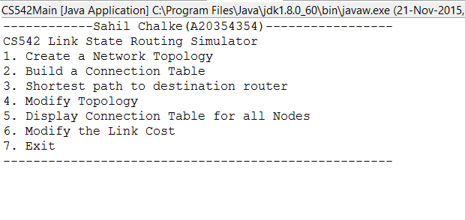
The Steps required to run the program are as follows
The following screen will be displayed in the console:
Please select the Option 1 which will load the “input.txt” file in the program and display the topology matrix.

Slide 5
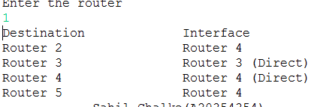
Selecting Option 2:
This will ask the user to input the Router number which he wants to see the connection table.
Suppose we input the Router number as 1 we will get the following output

Slide 6
Option 3: To find the shortest path between the source and destination router
We need to enter the Source Router and the Destination Router.
The program will output the path between the source and destination router
It will also display the total cost between the source and destination router.

Slide 7
Select Option 4: If we need to delete the router from the topology.
The program will ask the user to input the router to be deleted.
The topology matrix will be displayed with the row and column of that particular router being made -1. This means that the router has no links in the topology.
Once the router is deleted the user needs to input the source and destination router to find the new shortest path.
The user will also get the option to display the connection table of the routers in these two cases.

Slide 8
Additional Functionalities
1. Minimum number of nodes be 8
Below is the topology matrix for 8 number of nodes.
0 3 -1 -1 -1 -1 -1 5
3 0 4 -1 -1 -1 -1 2
-1 4 0 3 -1 -1 6 8
-1 -1 3 0 9 2 1 -1
-1 -1 -1 9 0 5 -1 -1
-1 -1 -1 2 5 0 2 -1
-1 -1 6 1 -1 2 0 7
5 2 8 -1 -1 -1 7 0
The program can run when the number of nodes are 8 or more.
It also works when we have number of nodes less than 8.
We can follow the same procedure from step 1 to step 5 when we input the text file with minimum number 8 number of nodes.

Slide 9
Selecting option 5: This will display the connection table of all the routers at one go.
No need to enter the router number as mentioned in option number 2.

Slide 10
Select Option 6: This option will enable the user to modify the link cost between the two routers.
The Routers should be neighbours in the topology.
If the routers are not the neighbours in the topology then the program will create the new link between the routers.
This is not acceptable as it will disturb the original topology.
The program will ask the user to input the 1st router and the 2nd router whose topology needs to be modified.
Then the user need input the cost which will be modifie between the two routers

Slide 11
The program will then display the new connection table for each of the routers at one go.
The program will ask the user to find the new shortest path between the source and the destination router.
The user needs to input the appropriate data to find the new shortest path.

Slide 12

To Exit the program user need to input the select option 7.
This will exit from the main program and the following message will be displayed
This marks the end of the program.

Slide 13


